Slide 1
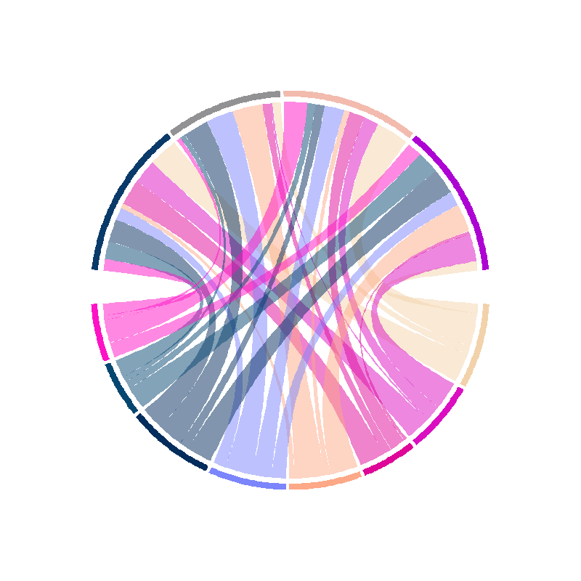
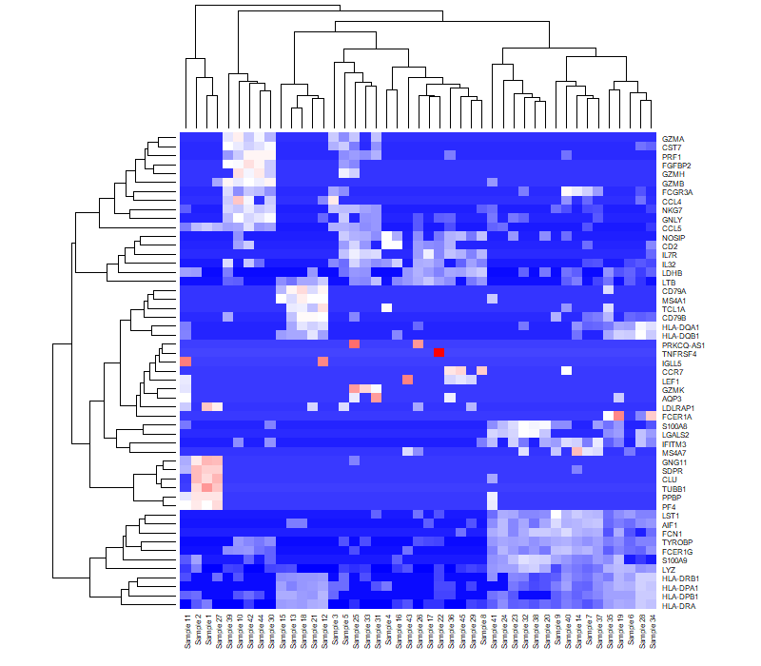
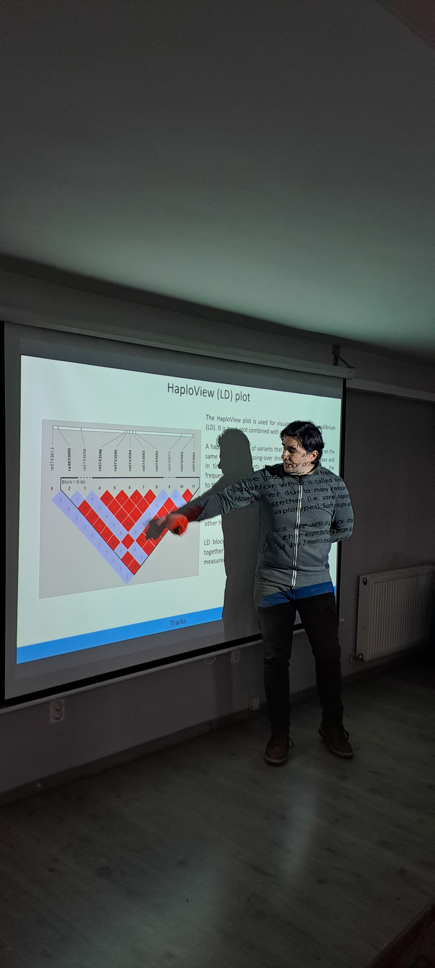
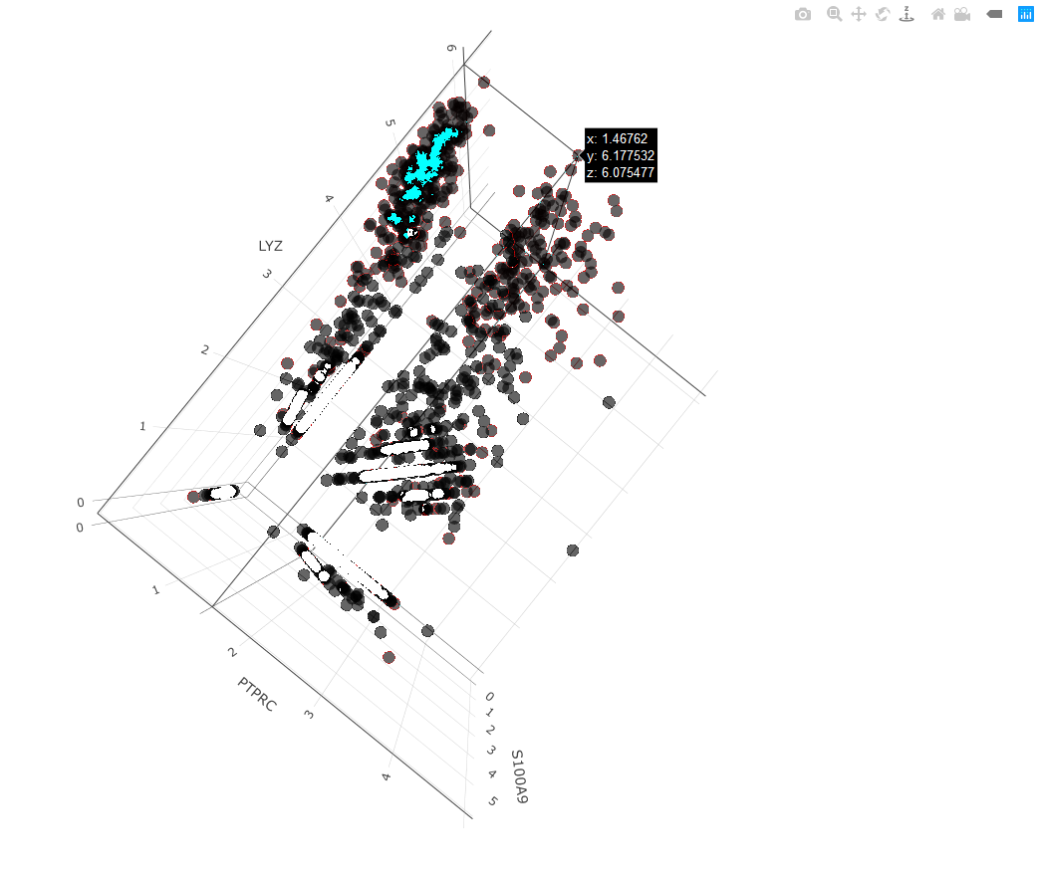
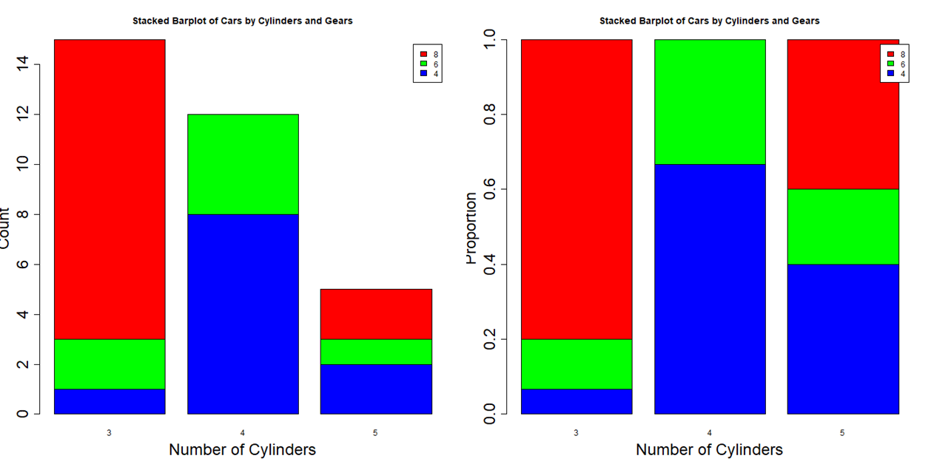
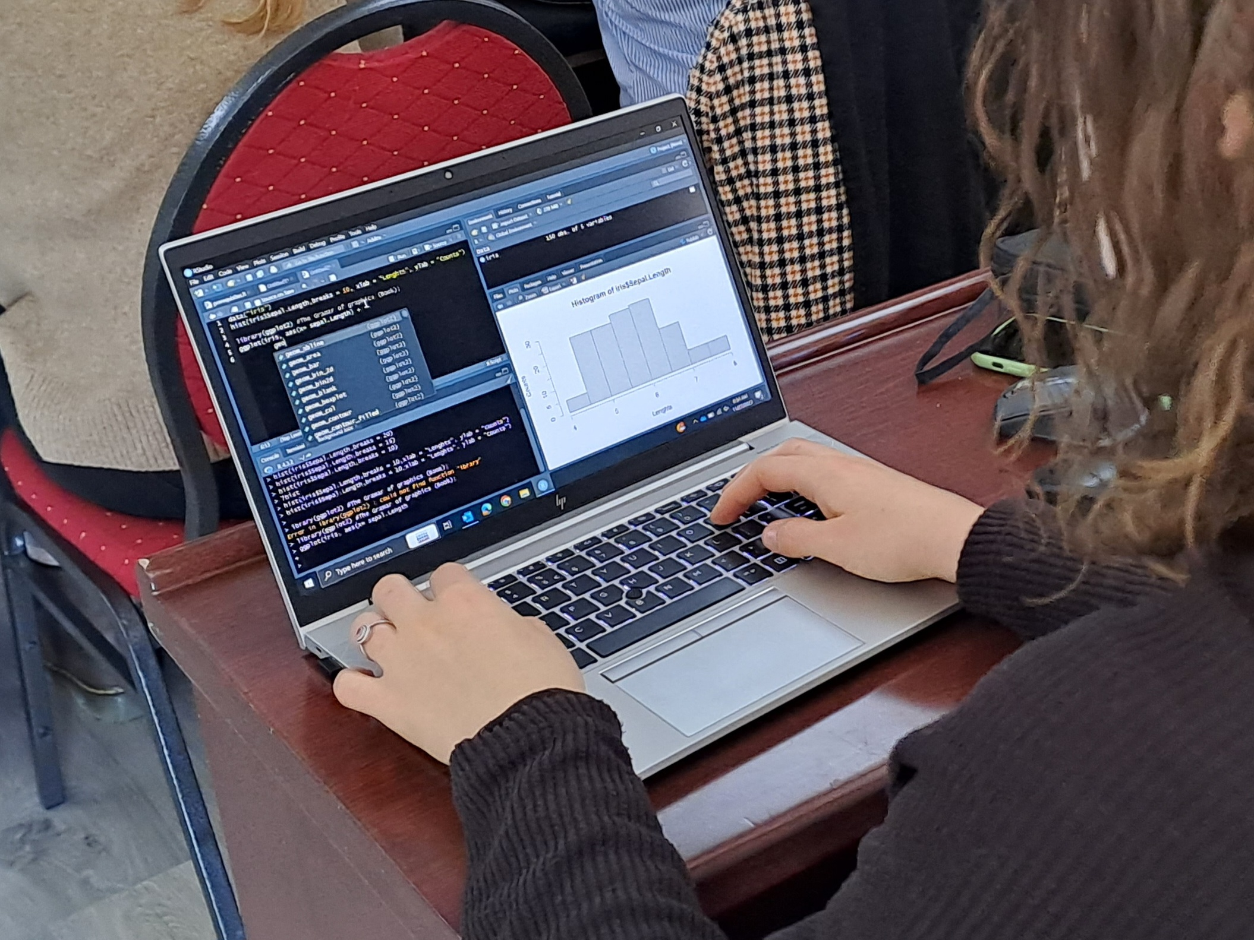
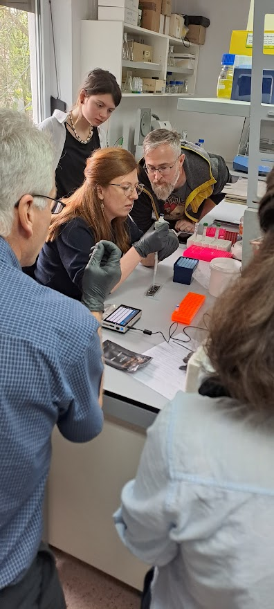
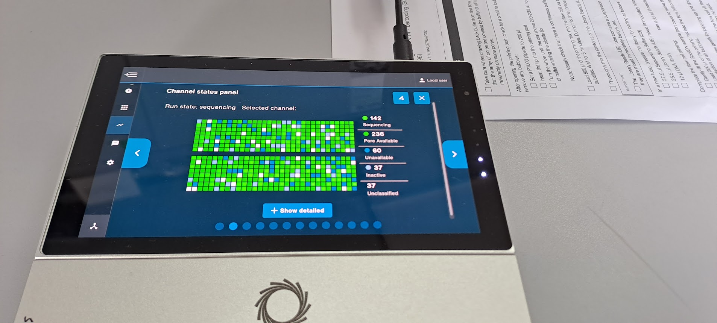
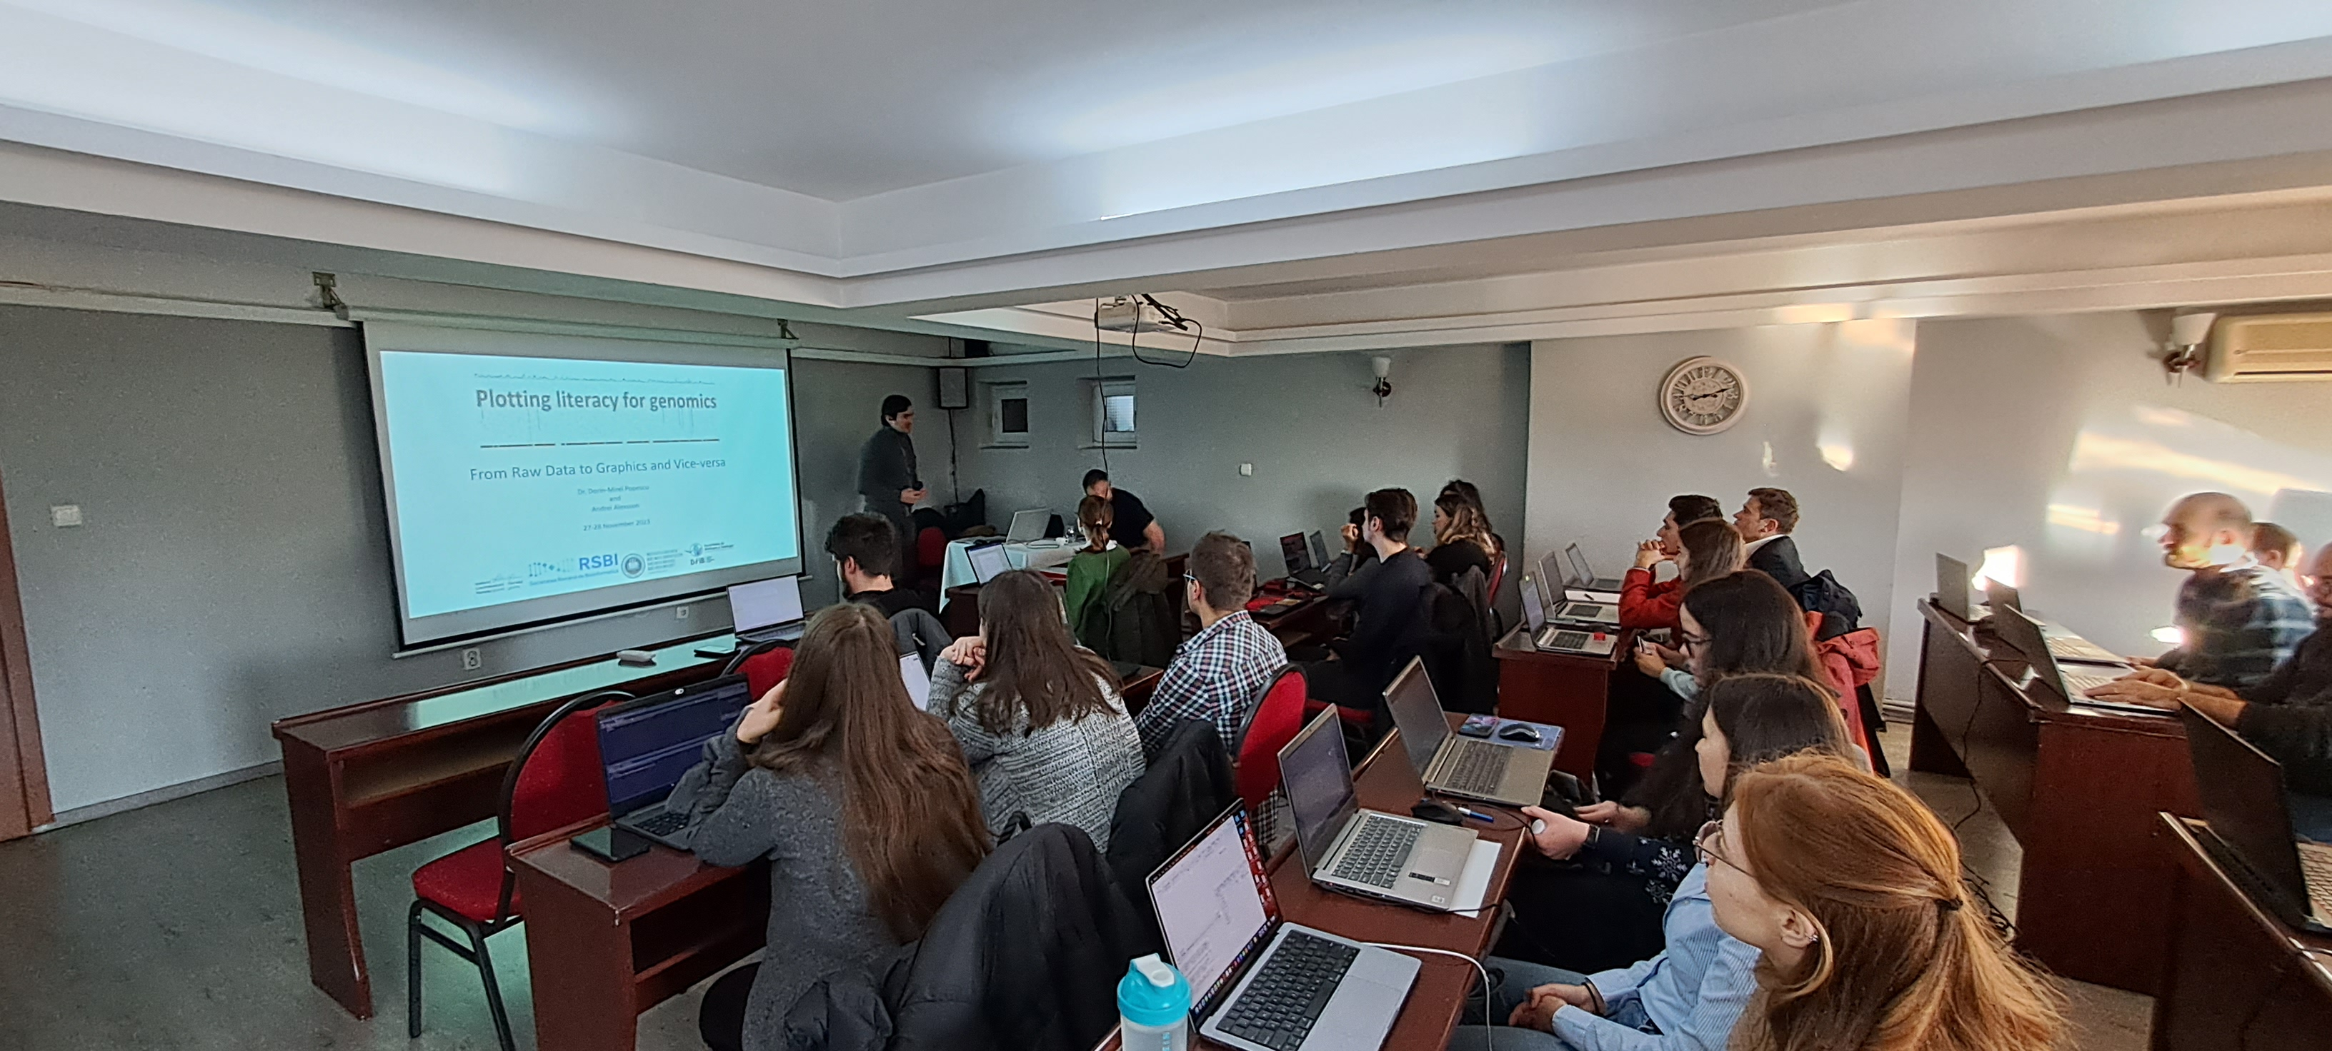
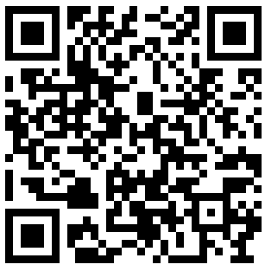
Master’s Program Bioinformatics Applied in Life Science (English)
000000
FACULTY OF BIOLOGY AND GEOLOGY
KEY FEATURES
120 ECTS credits, 4 semesters, full-time program
The only Bioinformatics Master’s program in Romania taught in English
Flexible curriculum tailored to biomedical and environmental bioinformatics
Strong academic and industry network, including collaborations with Romanian and international experts
Partnerships with private and public entities, providing internship and research opportunities
CAREER OPPORTUNITIES
Graduates of this research-oriented Master program can pursue careers in:
Research and development in life sciences, biotechnology, and genomics.
Data mining, biocuration, and software development.
Academic research (PhD) in computational biology and life sciences.
Roles such as Research assistant in biology/bioinformatics.
CURRICULUM
Computational skills
Molecular biology skills
1st semester: Introductory courses in molecular biology and informatics to strengthen students' backgrounds.
2nd and 3rd semesters: Advanced courses including Structural Bioinformatics, Applied Statistics, Advanced Programming, Big Data Processing, and Machine Learning in Bioinformatics. Students can specialize in biomedical or environmental bioinformatics.
4th semester: Individual research project and internship, with support from over 10 public and private R&D companies.
Biomedical bioinformatics
Environmental bioinformatics
Individual project
Internship
Dissertation
TARGET CANDIDATES & ADMISSION
Open to graduates with a background in STEM, life sciences, health and medical sciences, or agriculture.
Admissions take place in July and September each year.
Admission score breakdown:
50% Interview (motivation and graduation thesis topic) and
50% Graduation average.
Apply in July or September
to join the program!
See https://biogeo.ubbcluj.ro/

